Slide 1

Insight into the FIAF Film Restoration Summer School 2016
Kadi Sikka
Film Archives of the National Archives of Estonia
2017

Slide 2
TABLE OF CONTENTS
Introduction
Workflow
Documentation
  Identification
  Condition report
Film repair
  Treatment
  Repair
Film scan
Film comparison
Digital restoration
Colour correction
Cataloguing
Storage
Literature
Internet sources

Slide 3
„No matter where the cinema goes, we cannot afford to lose sight of its beginnings.“
Martin Scorsese

Slide 4
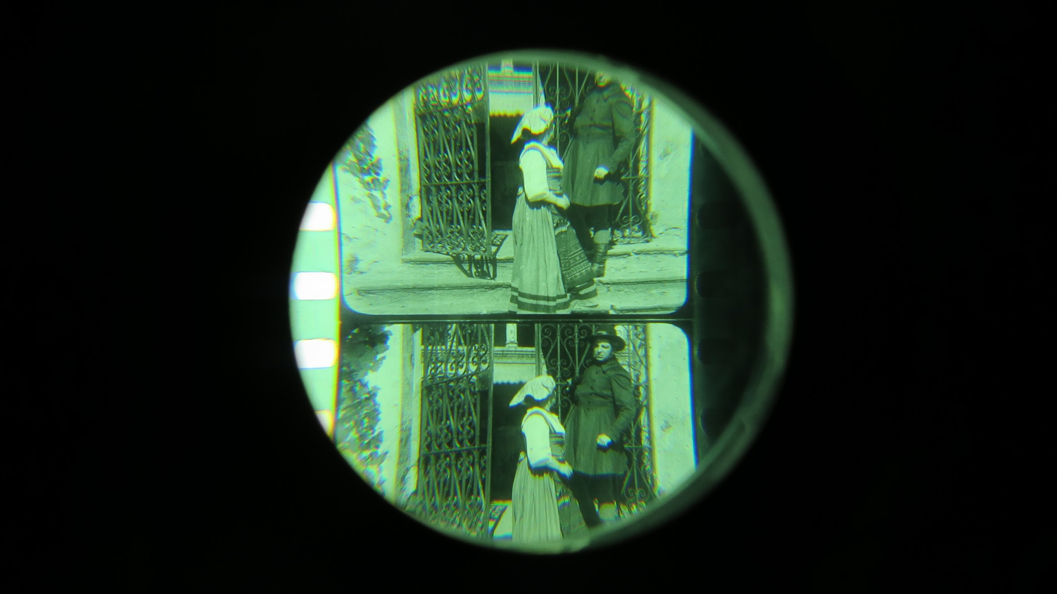
Photo: Kadi Sikka, L’Immagine Ritrovata

Slide 5
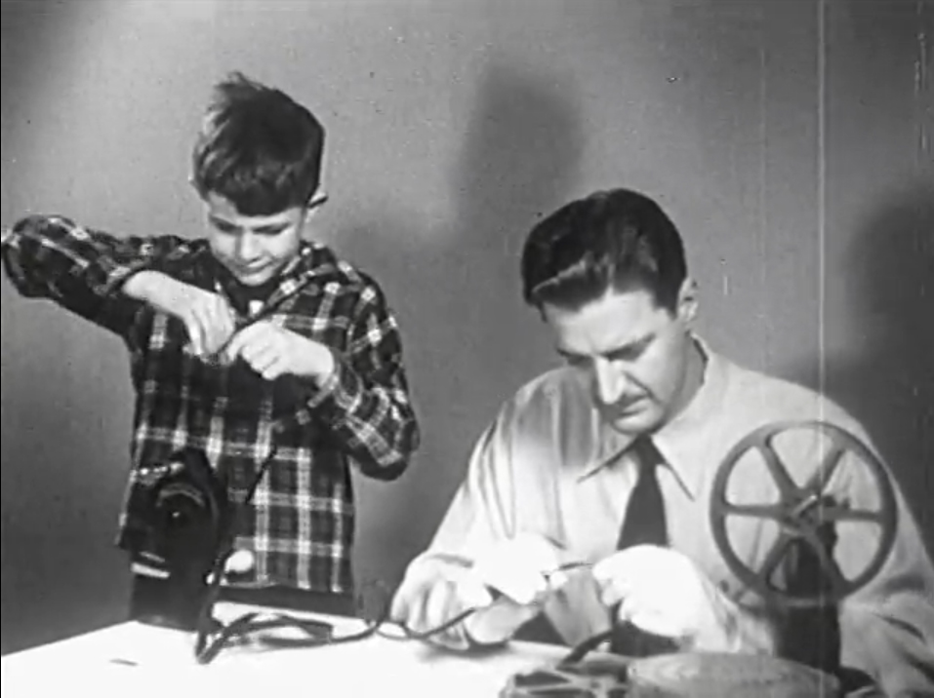
Facts About Film by Phototronics, Inc., 1948. Prelinger Archives (NY) / link

Slide 6
Stripped to its basic essentials, film restoration means finding some way of reproducing the experience of viewing a film in the context and empirical conditions of its original production and/or reception, in circumstances when the film no longer exists in its original form, the viewing conditions no longer exist or both.
Leo Enticknap. Film Restoration. The Culture and Science of Audiovisual Heritage, 2013, p. 11

Slide 7
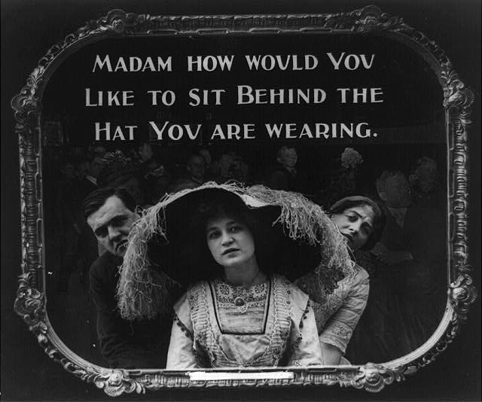
Lantern slide used in motion picture theatres as announcement, c1912.
Library of Congress (Washington D.C.), LC-USZ62-8646 / link

Slide 8
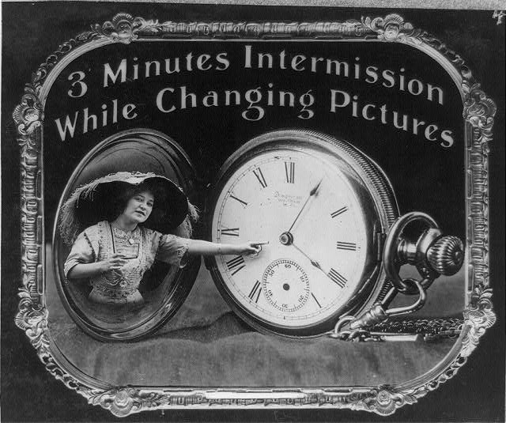
Lantern slide used in motion picture theatres as announcement, c1912.
Library of Congress (Washington D.C.), LC-USZ62-11575 / link

Slide 9
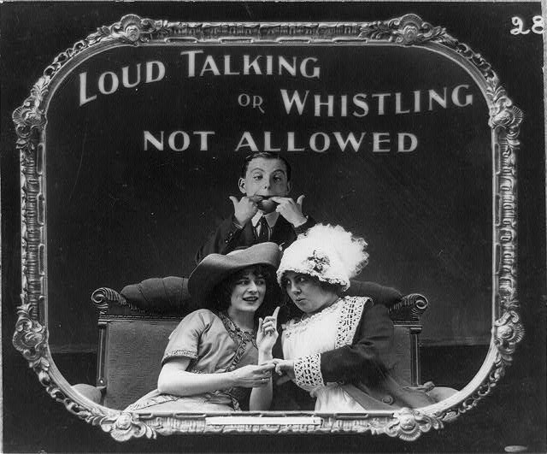
Lantern slide used in motion picture theatres as announcement, c1912.
Library of Congress (Washington D.C.), LC-USZ62-11574 / link

Slide 10
Film restoration is different from all restoration in other fields, where a tradition is already established. Whereas those traditions typically imply work on an original artefact, film restoration implies duplication and/or reconstruction.
A charter on film restoration (FIAF, 2011)

Slide 11
Like the mass distribution of the written word,
moving image media depend entirely on their ability to be copied.
Films are initially products of the technologies of their time,
but are usually seen today through very different technologies.
Leo Enticknap. Film Restoration. The Culture and Science of Audiovisual Heritage, 2013, p. 16, 21

Slide 12
Defining the object of film restoration consists of aiming at several, moving targets. Certain factors lie within restorer's control, for example:
the sequence of images;
technologies used to reproduce image characteristics;
steps which are taken in order to reverse the aesthetic evidence of physical damage or decomposition;
whether the final output is photochemical, digital or both.
Leo Enticknap. Film Restoration. The Culture and Science of Audiovisual Heritage, 2013, p. 16, 21

Slide 13
WORKFLOW

Slide 14
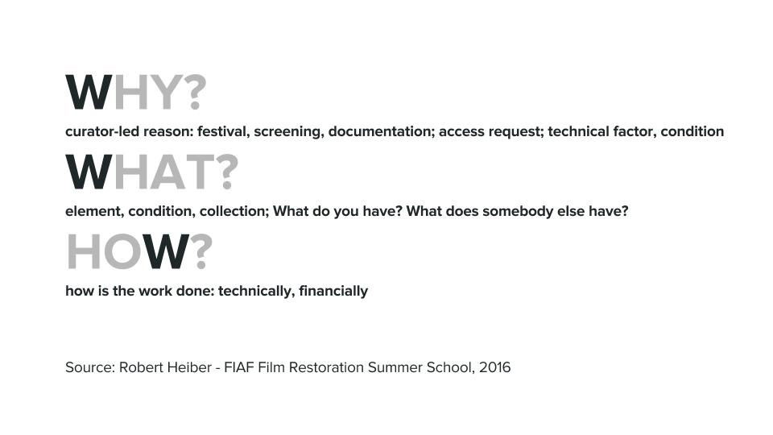

Slide 15
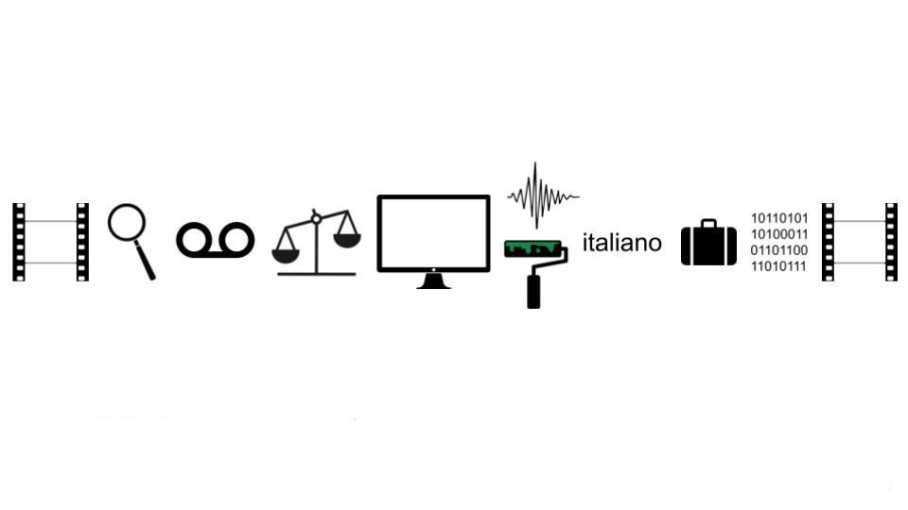
1. Identification and repair
2. Film scan
3. Film comparison
4. Digital restoration: image & sound
5. Colour correction
6. Subtitling and mastering
7. Digital asset management
8. Print & processing
9. Cataloguing and storage
ID - Repair - Scan - Comparison - Digital restoration - Colour correction - Sound restoration -
- Subtitling - Film mastering - Digital asset management (DAM) - Print & processing

Slide 16
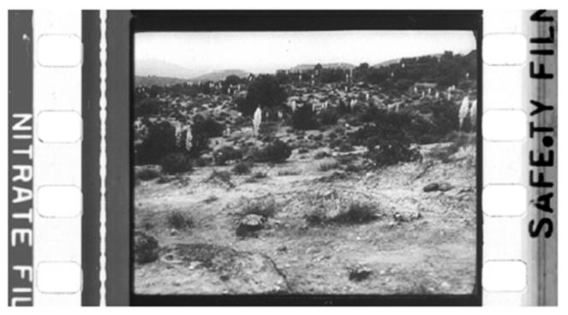
Identification: nitrate vs acetate
From: David Walsh (Approaches to Film Preservation and Archive Management - FIAF FRSS, 2016)

Slide 17
DOCUMENTATION
IDENTIFICATION
CONDITION REPORT

Slide 18
TECHNICAL DOCUMENTATION and the analysis of the available elements and non-filmic sources gives the idea of the complexity of restoration. It allows to plan the most appropriate restoration workflow and establish a timeframe for the conclusion of the work.

Slide 19
IDENTIFICATION

Slide 20
GENERATION refers to where a copy of a film or video stands in relation to the original material. For example, any camera original material is referred to as the “0” (zero) generation.
NFSA glossary / link

Slide 21
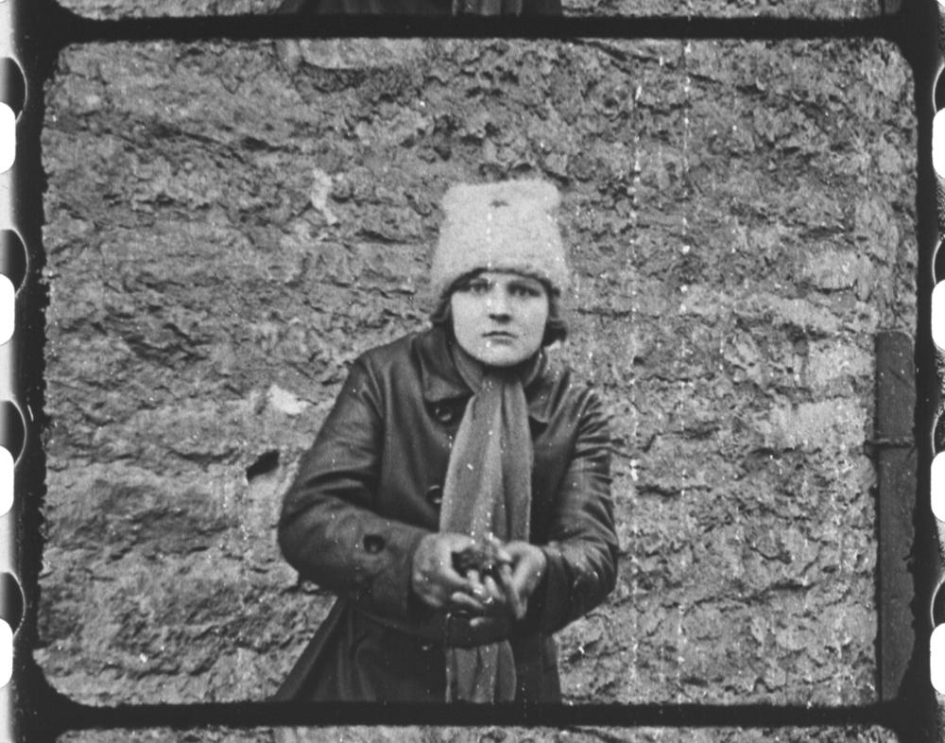
ID OF FILM
GENERATION
Tšekaa komissar Miroštšenko, 1925
dir. Paul Sehnert
(Eesti National Film)
feature
b/w 35 mm, silent
nitrate print, 01:17:42
Estonian Film Archives
EFA f 13 P-384 / EFA link

Slide 22
TONING is colouring of the motion picture film by chemical reaction with the developed silver image.
TINTING, as opposed to a toned print, does not affect the silver image. It is a colouring of the entire base, not a colouring of the silver images. A tinted print will have the colour from edge to edge of the film, including the perforated margins.
NFSA glossary / link (tinting), link (toning)
Timeline of Historical Film Colors / link

Slide 23
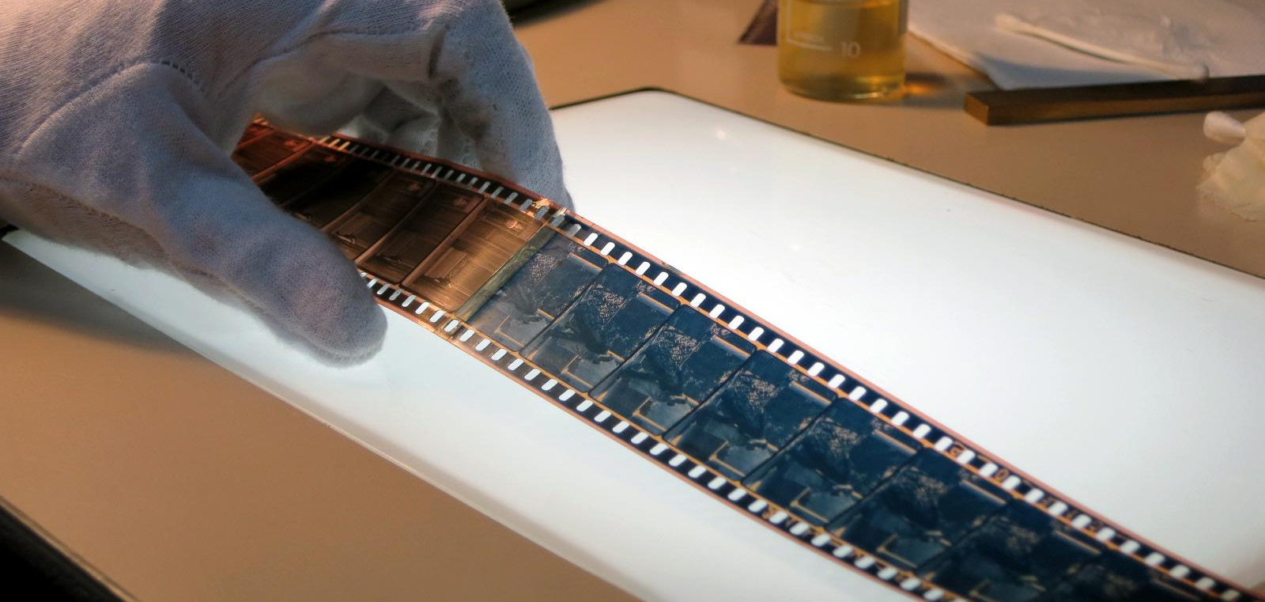
Identification of pink tinting and blue toning. Photo: Kadi Sikka, L’Immagine Ritrovata

Slide 24
SPLICE is when a film has to be cemented or taped together because of breakage or as part of the editing process.
Tape splices
Cement splices
Ultrasonic splices
NFSA glossary / link

Slide 25
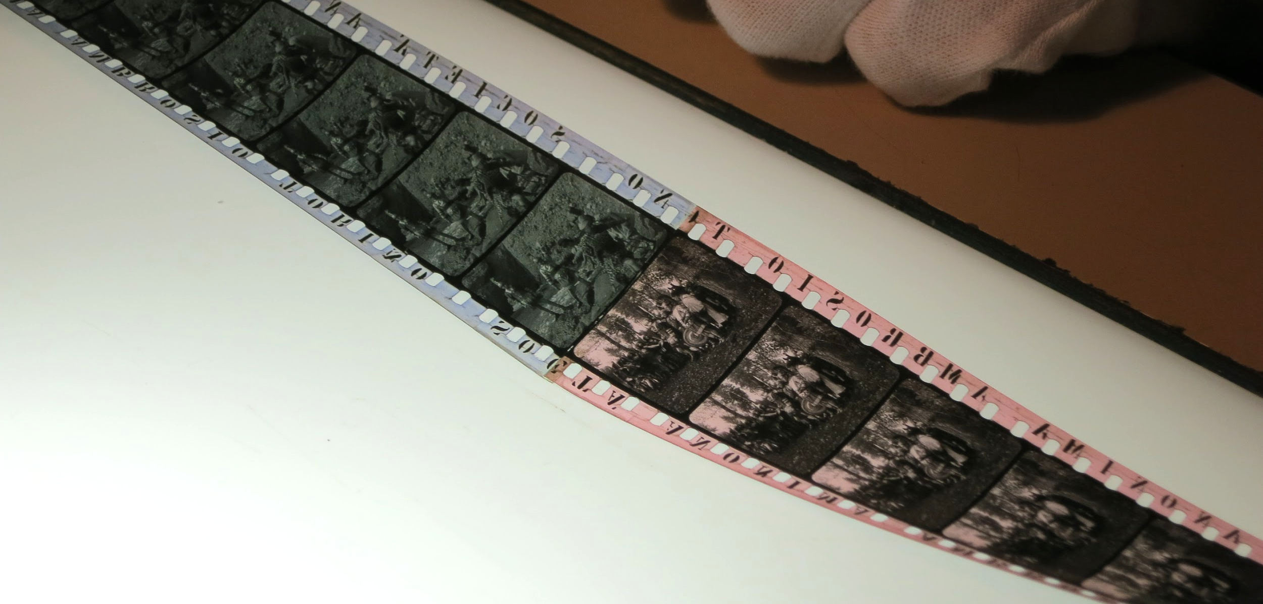
Identification of production company and tinting (pink and blue). Photo: Kadi Sikka, L’Immagine Ritrovata

Slide 26
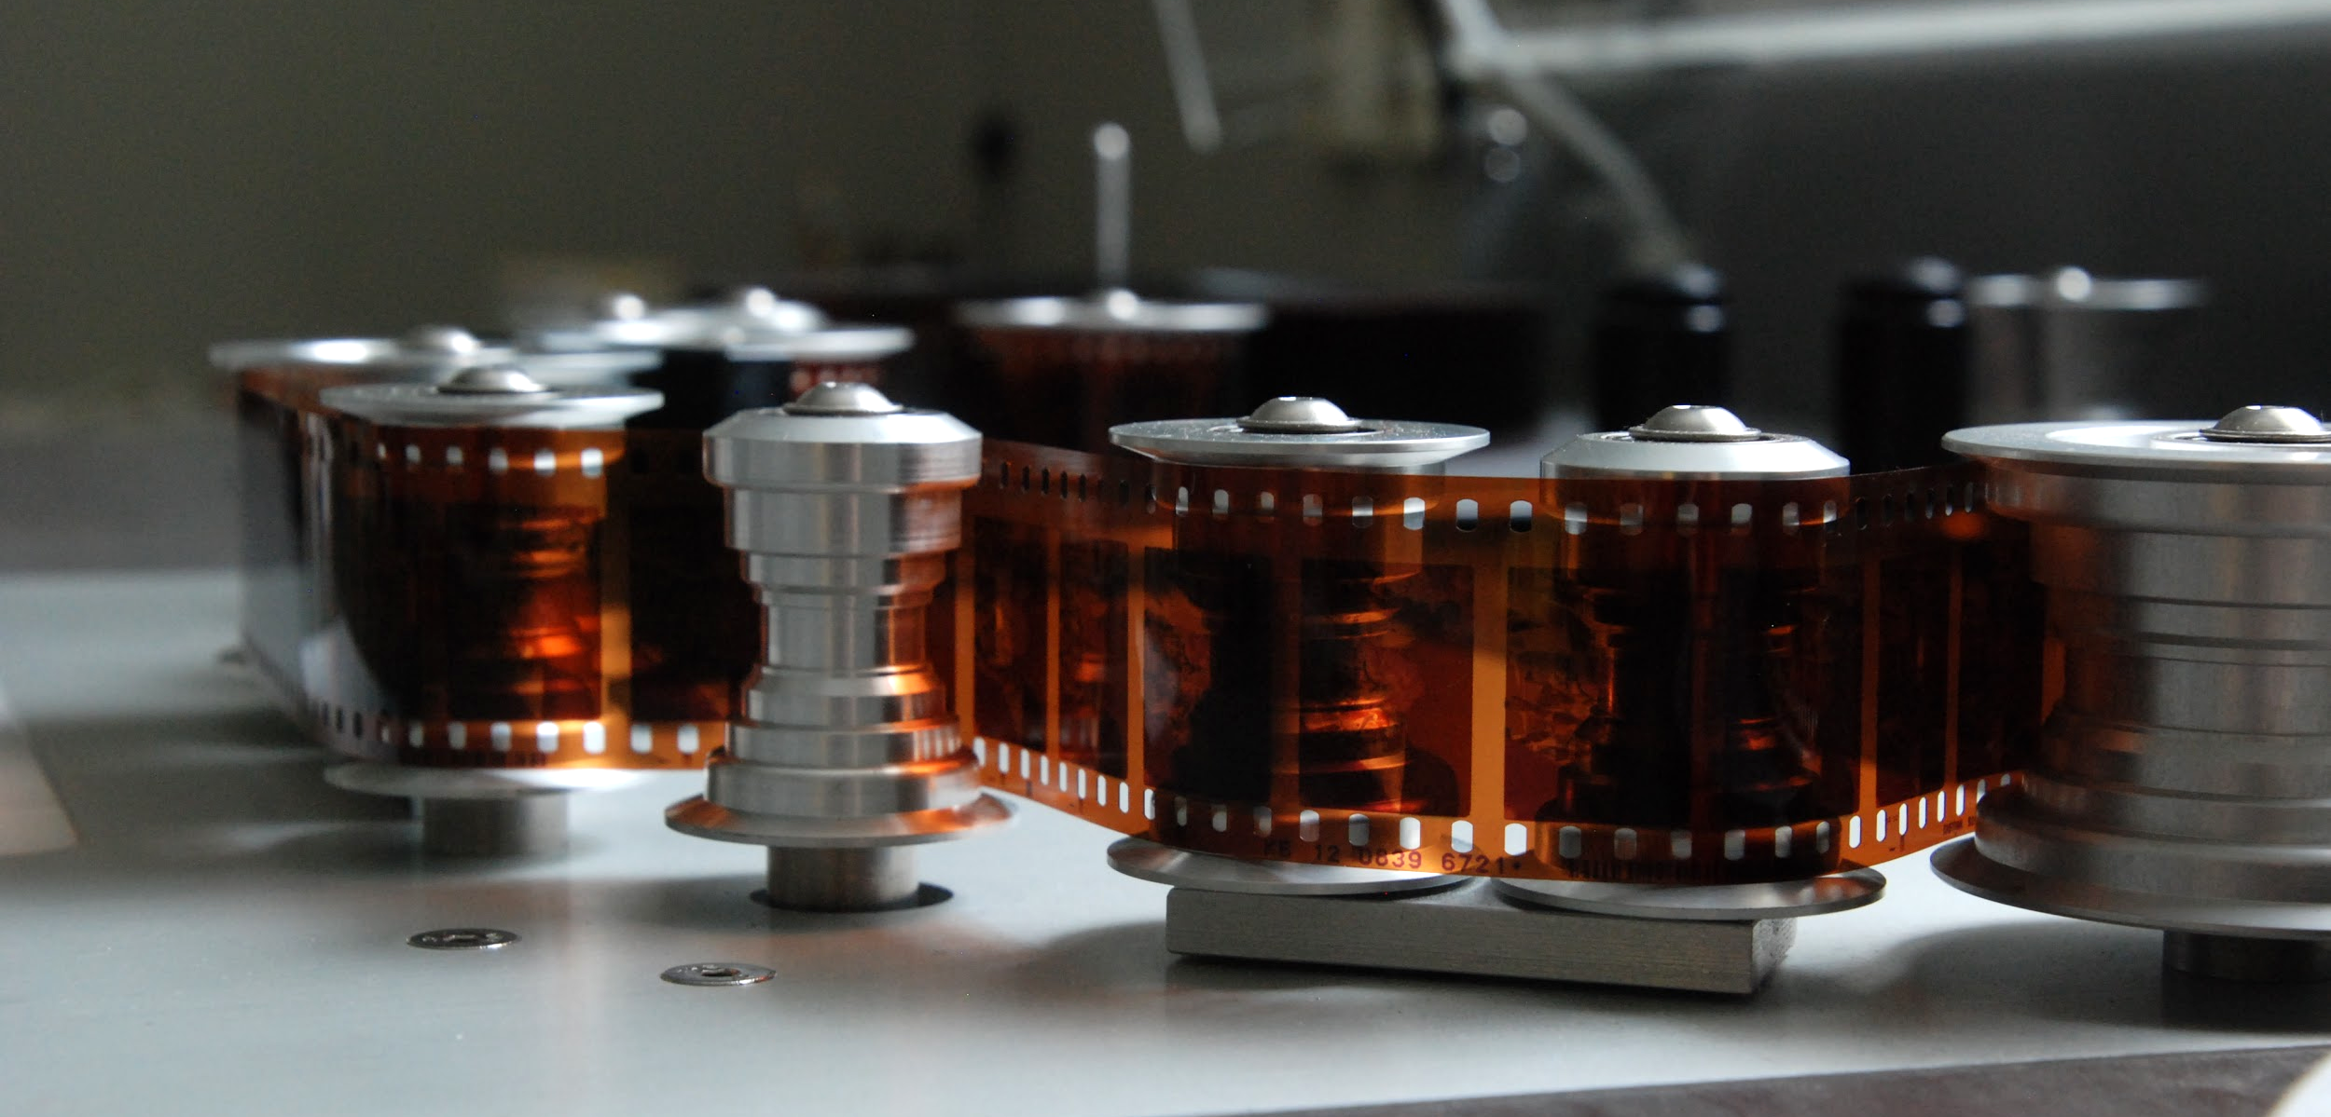
Inspection on the Ernemann winding table Spinner. Photo: Kadi Sikka, Film Archives

Slide 27
CONDITION REPORT

Slide 28
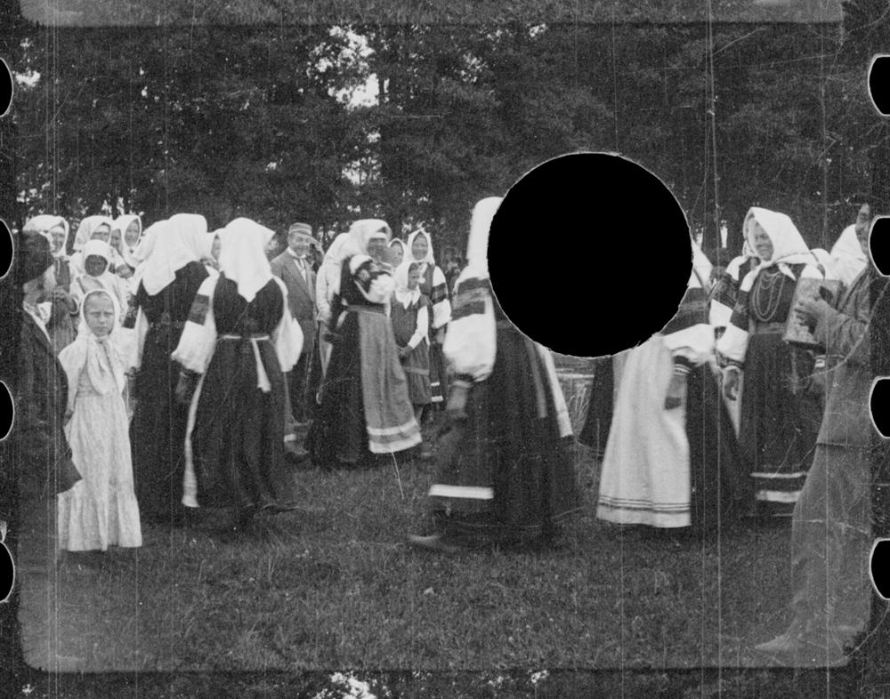
LOSS OF BASE
Retk läbi Setumaa, 1913
author Johannes Pääsuke
(Estonia Film)
documentary
b/w 35 mm, silent
nitrate negative, 00:06:40
Estonian Film Archives
EFA f 15 N-2 / EFA link

Slide 29
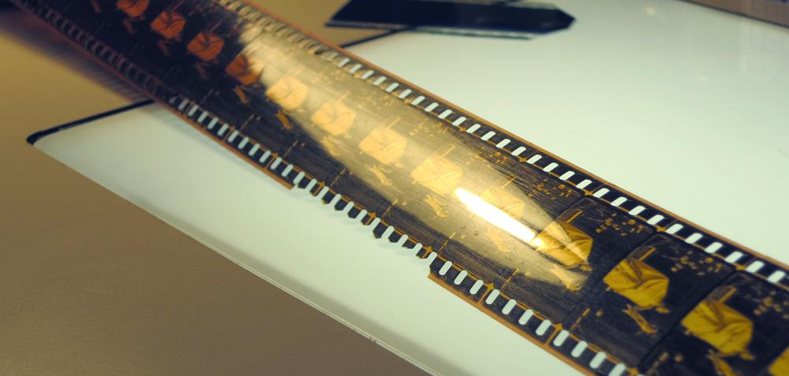
Loss of base. Photo: Kadi Sikka, L’Immagine Ritrovata

Slide 30
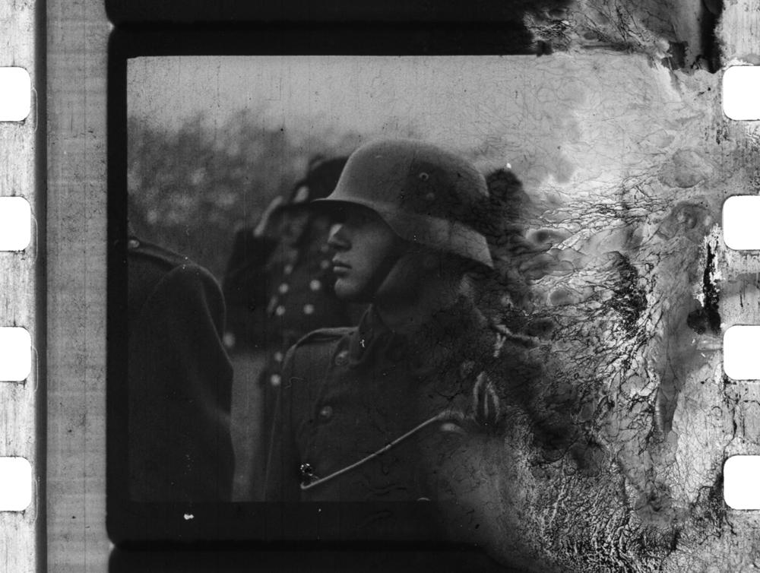
DECOMPOSITION OF NITRATE
UFA newsreel No. 535, 1942
newsreel
b/w 35 mm, sound
nitrate print
Estonian Film Archives
EFA f 458 P-2793 / EFA link

Slide 31
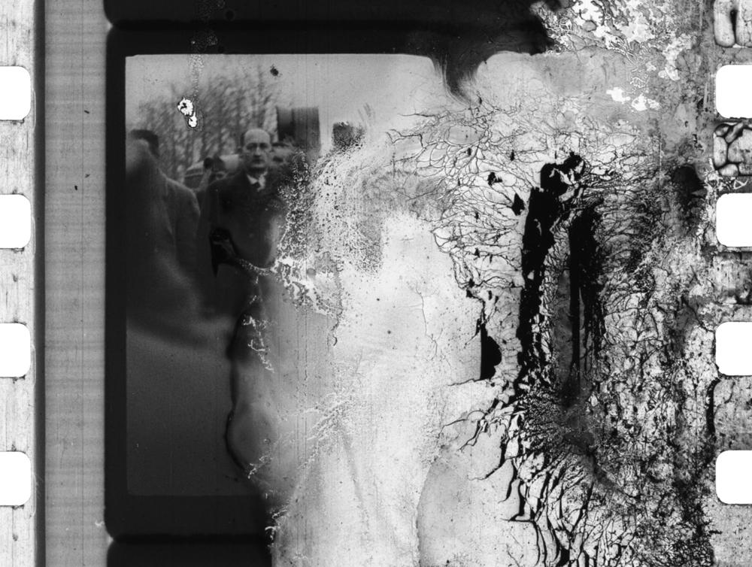
DECOMPOSITION OF NITRATE
UFA newsreel No. 535, 1942
newsreel
b/w 35 mm, sound
nitrate print
Estonian Film Archives
EFA f 458 P-2793 / EFA link

Slide 32
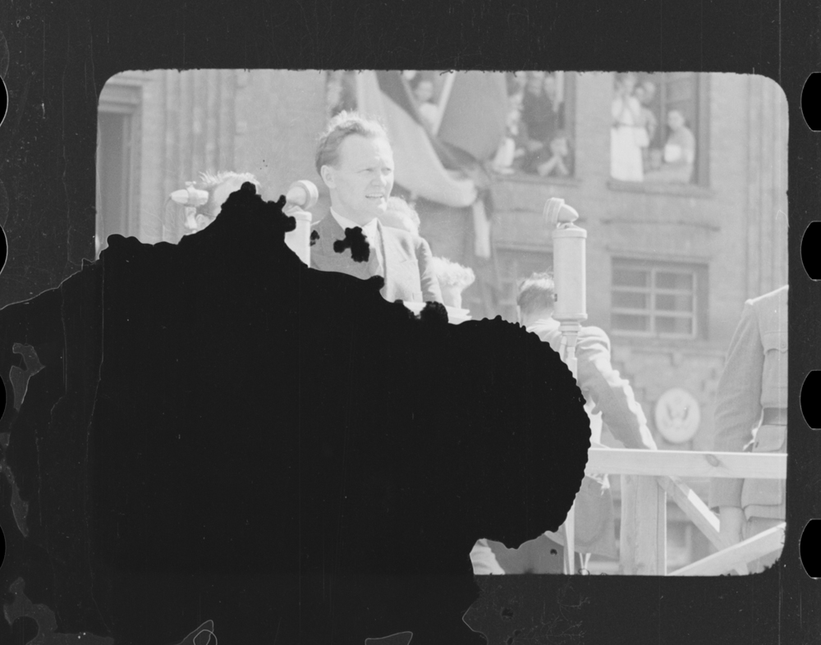
LOSS OF EMULSION
Rahva tahe, 1940
(Eesti Kultuurfilm)
documentary
b/w 35 mm, sound
nitrate negative, 00:51:32
Estonian Film Archives
EFA f 4 N-422 / EFA link

Slide 33
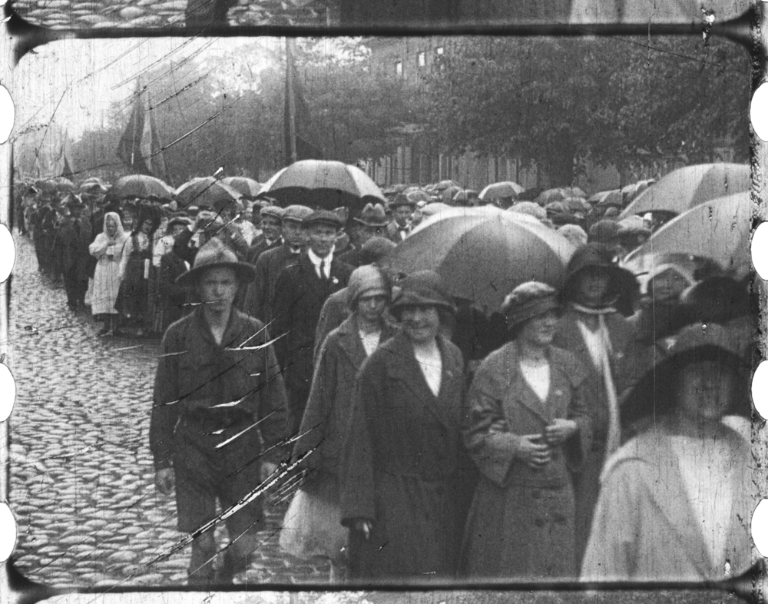
SCRATCHES
VIII Üldlaulupidu Tallinn, 1923
(Estonia Film)
newsreel
b/w 35 mm, silent
nitrate print, 00:21:32
Estonian Film Archives
EFA f 14 P-11 / EFA link

Slide 34
Research carried out by a Kodak scientist in 1948 indicated that a typical nitrate print had a lifespan of 644 projections before mechanical failure.
Leo Enticknap. Film Restoration. The Culture and Science of Audiovisual Heritage, 2013, p. 30

Slide 35
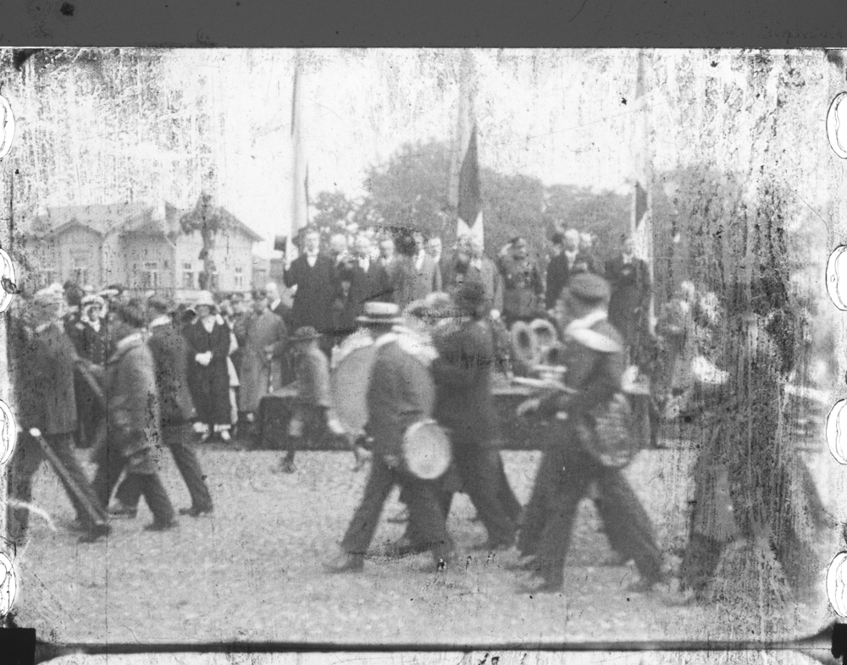
DIRT,
ABRASION
VIII Üldlaulupidu Tallinn, 1923
(Estonia Film)
newsreel
b/w 35 mm, silent
nitrate print, 00:21:32
Estonian Film Archives
EFA f 14 P-11 / EFA link

Slide 36
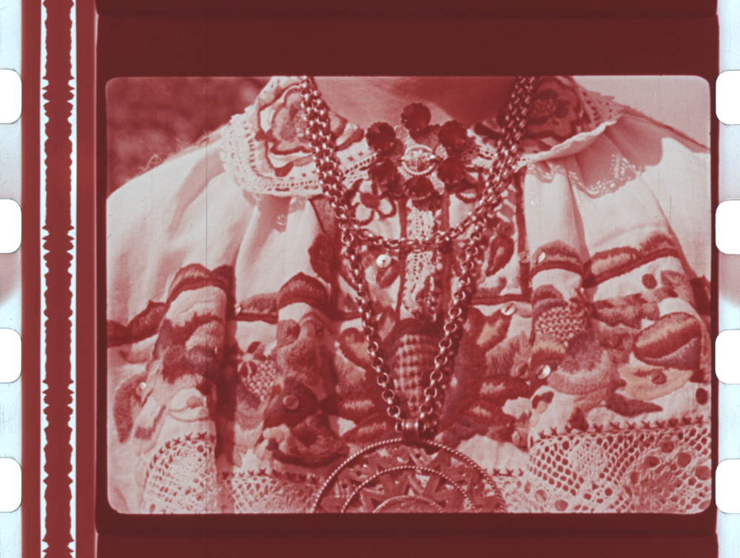
COLOUR SHIFT
Ilu meie ümber, 1960
dir. Reet Kasesalu
(Kunstiliste ja Kroonikafilmide Tallinna Kinostuudio)
documentary
colour 35 mm, sound
nitrate print, 00:19:59
Estonian Film Archives
EFA f 203 P-1428 / EFA link

Slide 37
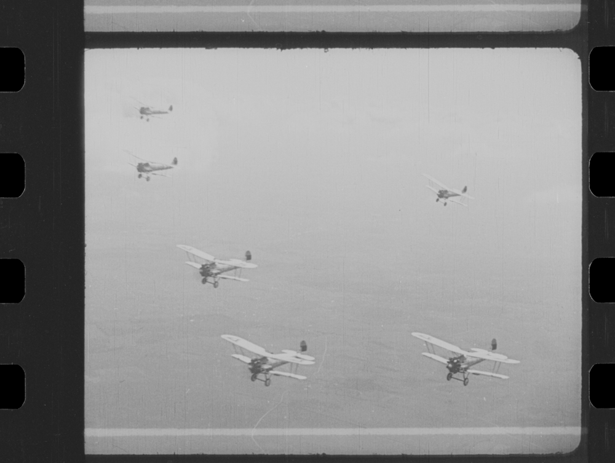
FRAME
CUT
Gaas! Gaas! Gaas!, 1931
dir. Theodor Luts (Theodor Lutsu Filmiproduktsioon)
The left side of the silent film frame has been cut due to copying process onto the sound film stock. Unfortunately, original negatives of these silent films are not preserved.
documentary
b/w 35 mm, silent, acetate
duplicate negative, 00:38:44
Estonian Film Archives
EFA f 23 DN-328 / EFA link

Slide 38
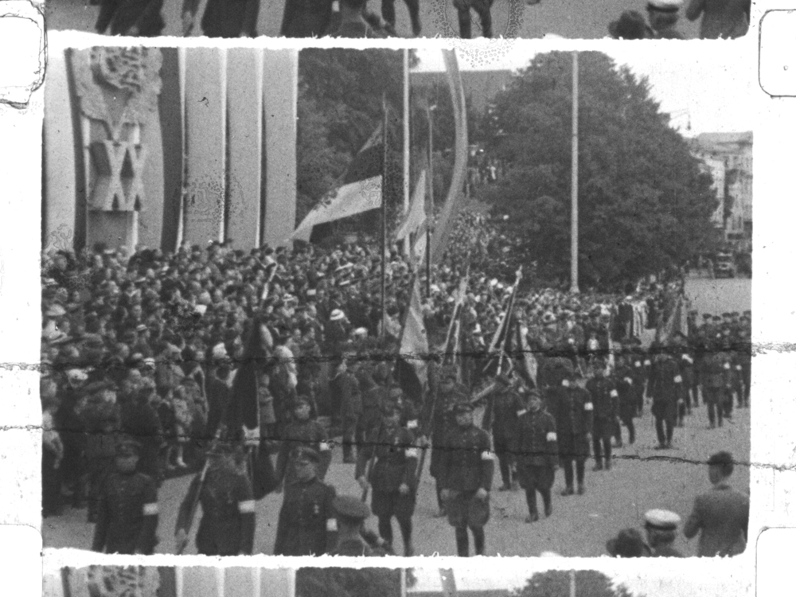
OLD
SPLICES
Relvastatud rahvas, 1938
(Eesti Kultuurfilm)
Old splices, residues of tape and glue in the middle of frames and around the perforation holes.
newsreel
b/w 16 mm, silent
acetate print, 00:05:47
Estonian Film Archives
EFA f 4 P-224 / EFA link

Slide 39
FILM REPAIR
TREATMENT
REPAIR

Slide 40
The aim is to restore the original film’s mechanical capability for its passage through the machines (cleaning machine, printer, scanner, etc.).
Before handling, the film might need chemical treatment:
re-hydration;
softening;
drying;
cleaning.

Slide 41
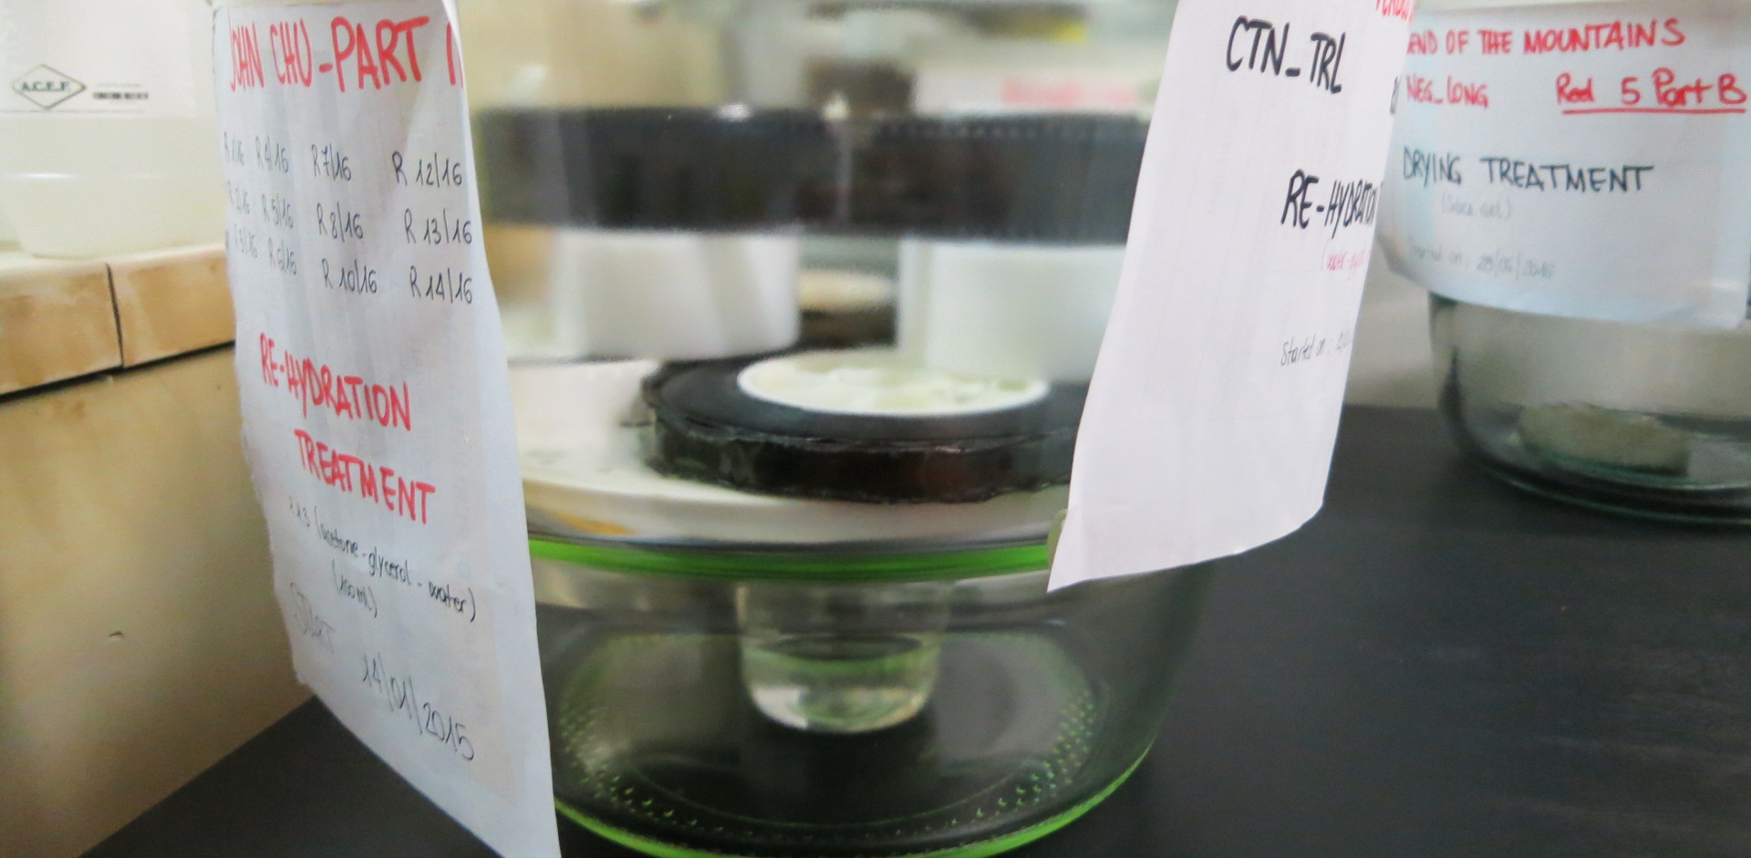
Re-hydration and drying treatment in the L’Immagine Ritrovata lab. Photo: Kadi Sikka

Slide 42
The reparation work is carried out on a rewinding table with the help of scissors, scalpels, tweezers, solvents, adhesive tape, glue and brush. Any physical damage, such as breakages, strains or tears, which may be located at the perforations or on the actual images is repaired.

Slide 43
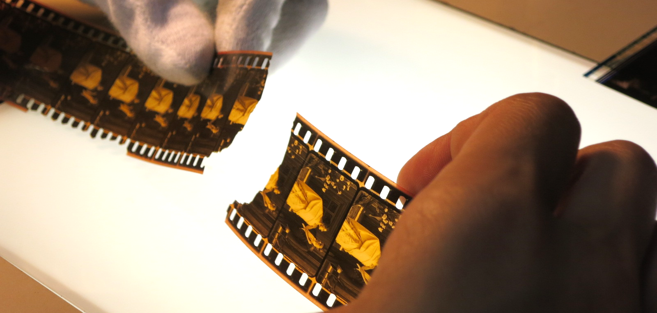
Film repair in the L’Immagine Ritrovata lab. Photo: Kadi Sikka

Slide 44
FILM REPAIR: SPLICING
Respect the original material, prefer reversible interventions;
Avoid film overlapping in tape splices;
Use the least possible amount of tape; avoid thickness which causes instability and focus problems during scanning;
Replace considerable lacunas, both in the perforation area and in the image area with polyester film.

Slide 45
LABORATORY EQUIPMENT: TAPES
Perforated and non-perforated transparent tapes
Splicing tapes: 38mm, 35mm, 25mm, 15mm
Suppliers:
Kodak www.kodak.com
Dancan www.dancan.dk
International Cinema Supplies www.cinemasuppliesonline.com
Philip Rigby www.philiprigby.co.uk
Wittner www.wittner-kinotechnik.de

Slide 46
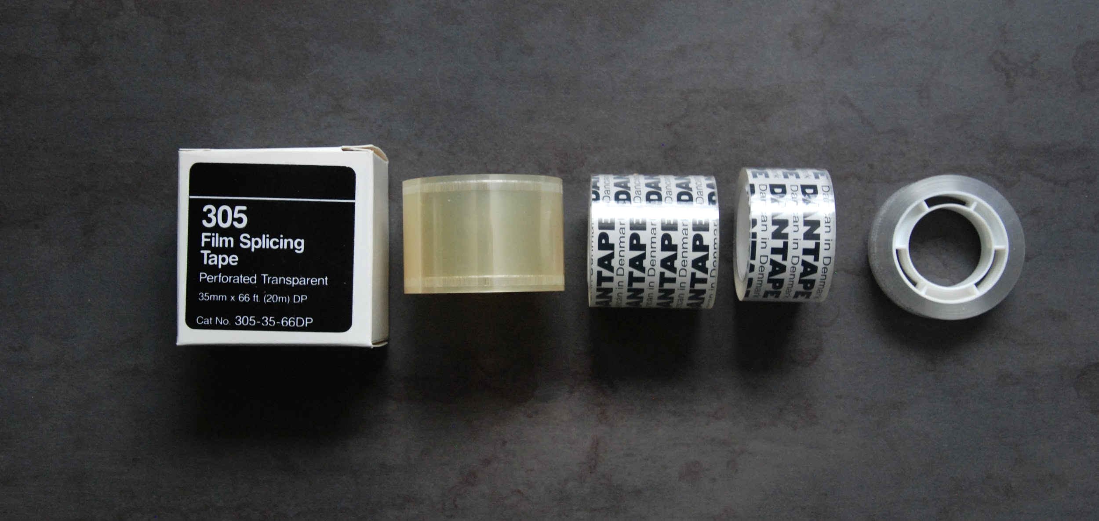
Repairing tapes. Photo: Kadi Sikka, Film Archives

Slide 47
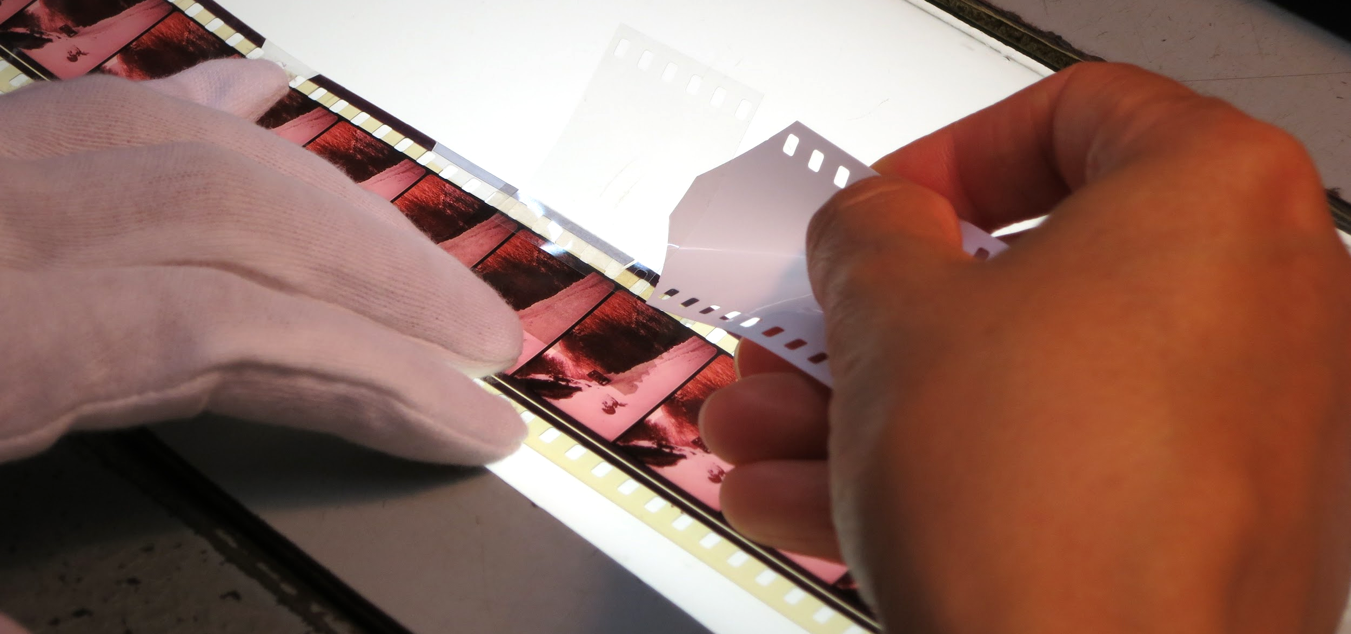
Repairing with 35 mm perforated tape in the L’Immagine Ritrovata lab. Photo: Kadi Sikka

Slide 48
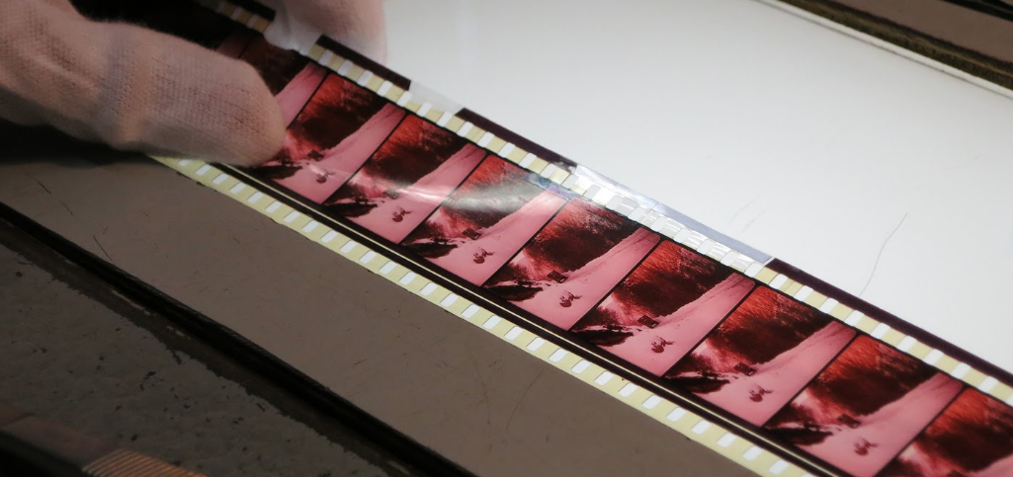
Reconstruction of perforation losses in the L’Immagine Ritrovata lab. Photo: Kadi Sikka

Slide 49
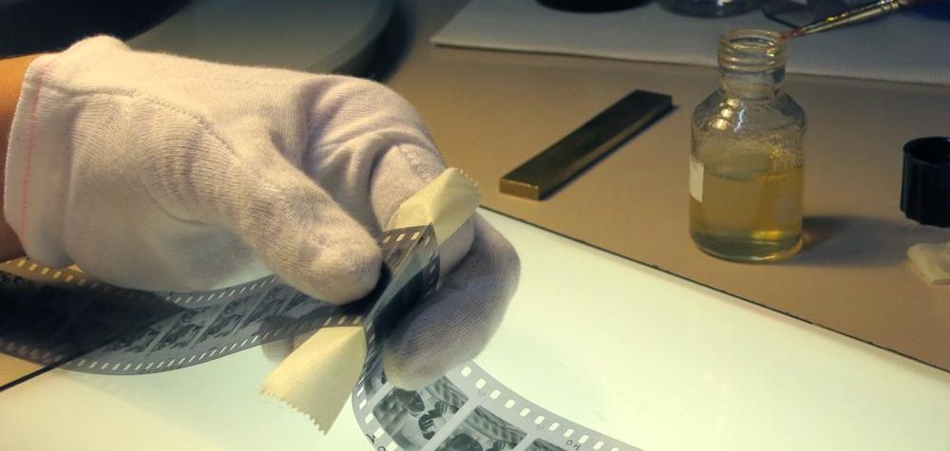
Resplicing with cement in the L’Immagine Ritrovata lab. Photo: Kadi Sikka

Slide 50
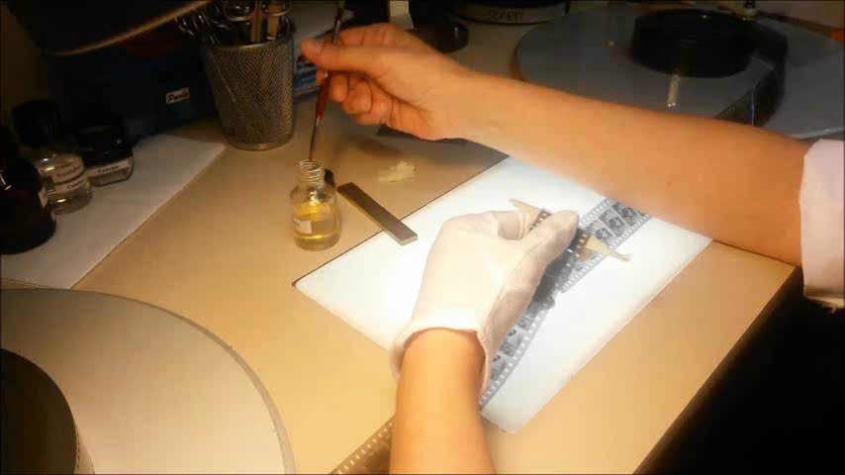
Resplicing with cement in the L’Immagine Ritrovata lab. Video: Kadi Sikka

Slide 51
FILM SCAN

Slide 52
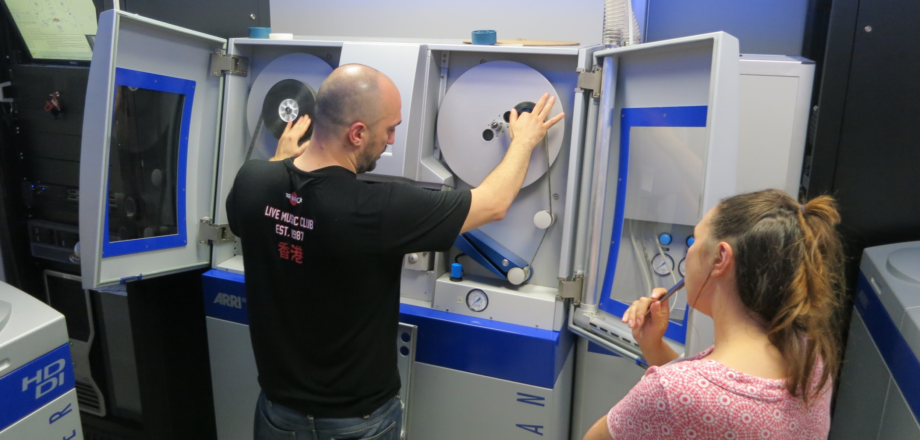
Arriscan in the L’Immagine Ritrovata lab. Photo: Kadi Sikka

Slide 53
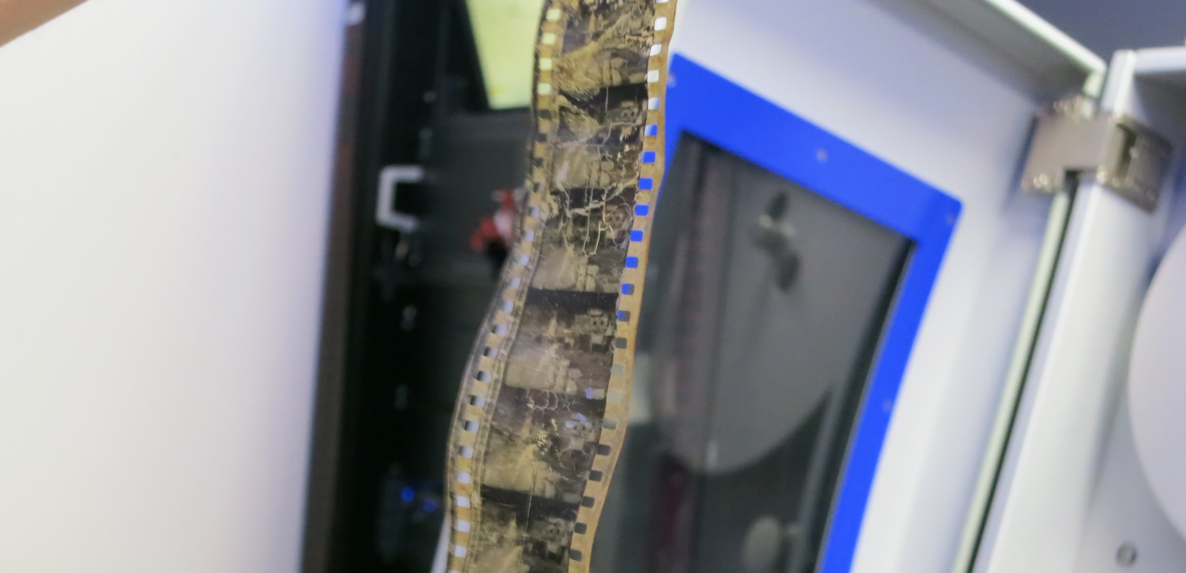
Deteriorated nitrate film, managed to scan with Arriscan in the L’Immagine Ritrovata lab. Photo: Kadi Sikka

Slide 54
FILM COMPARISON

Slide 55
Film comparison means assembling content from multiple source elements in which the sequence of content, as originally assembled, is known, but does not survive in any surviving element.

Slide 56
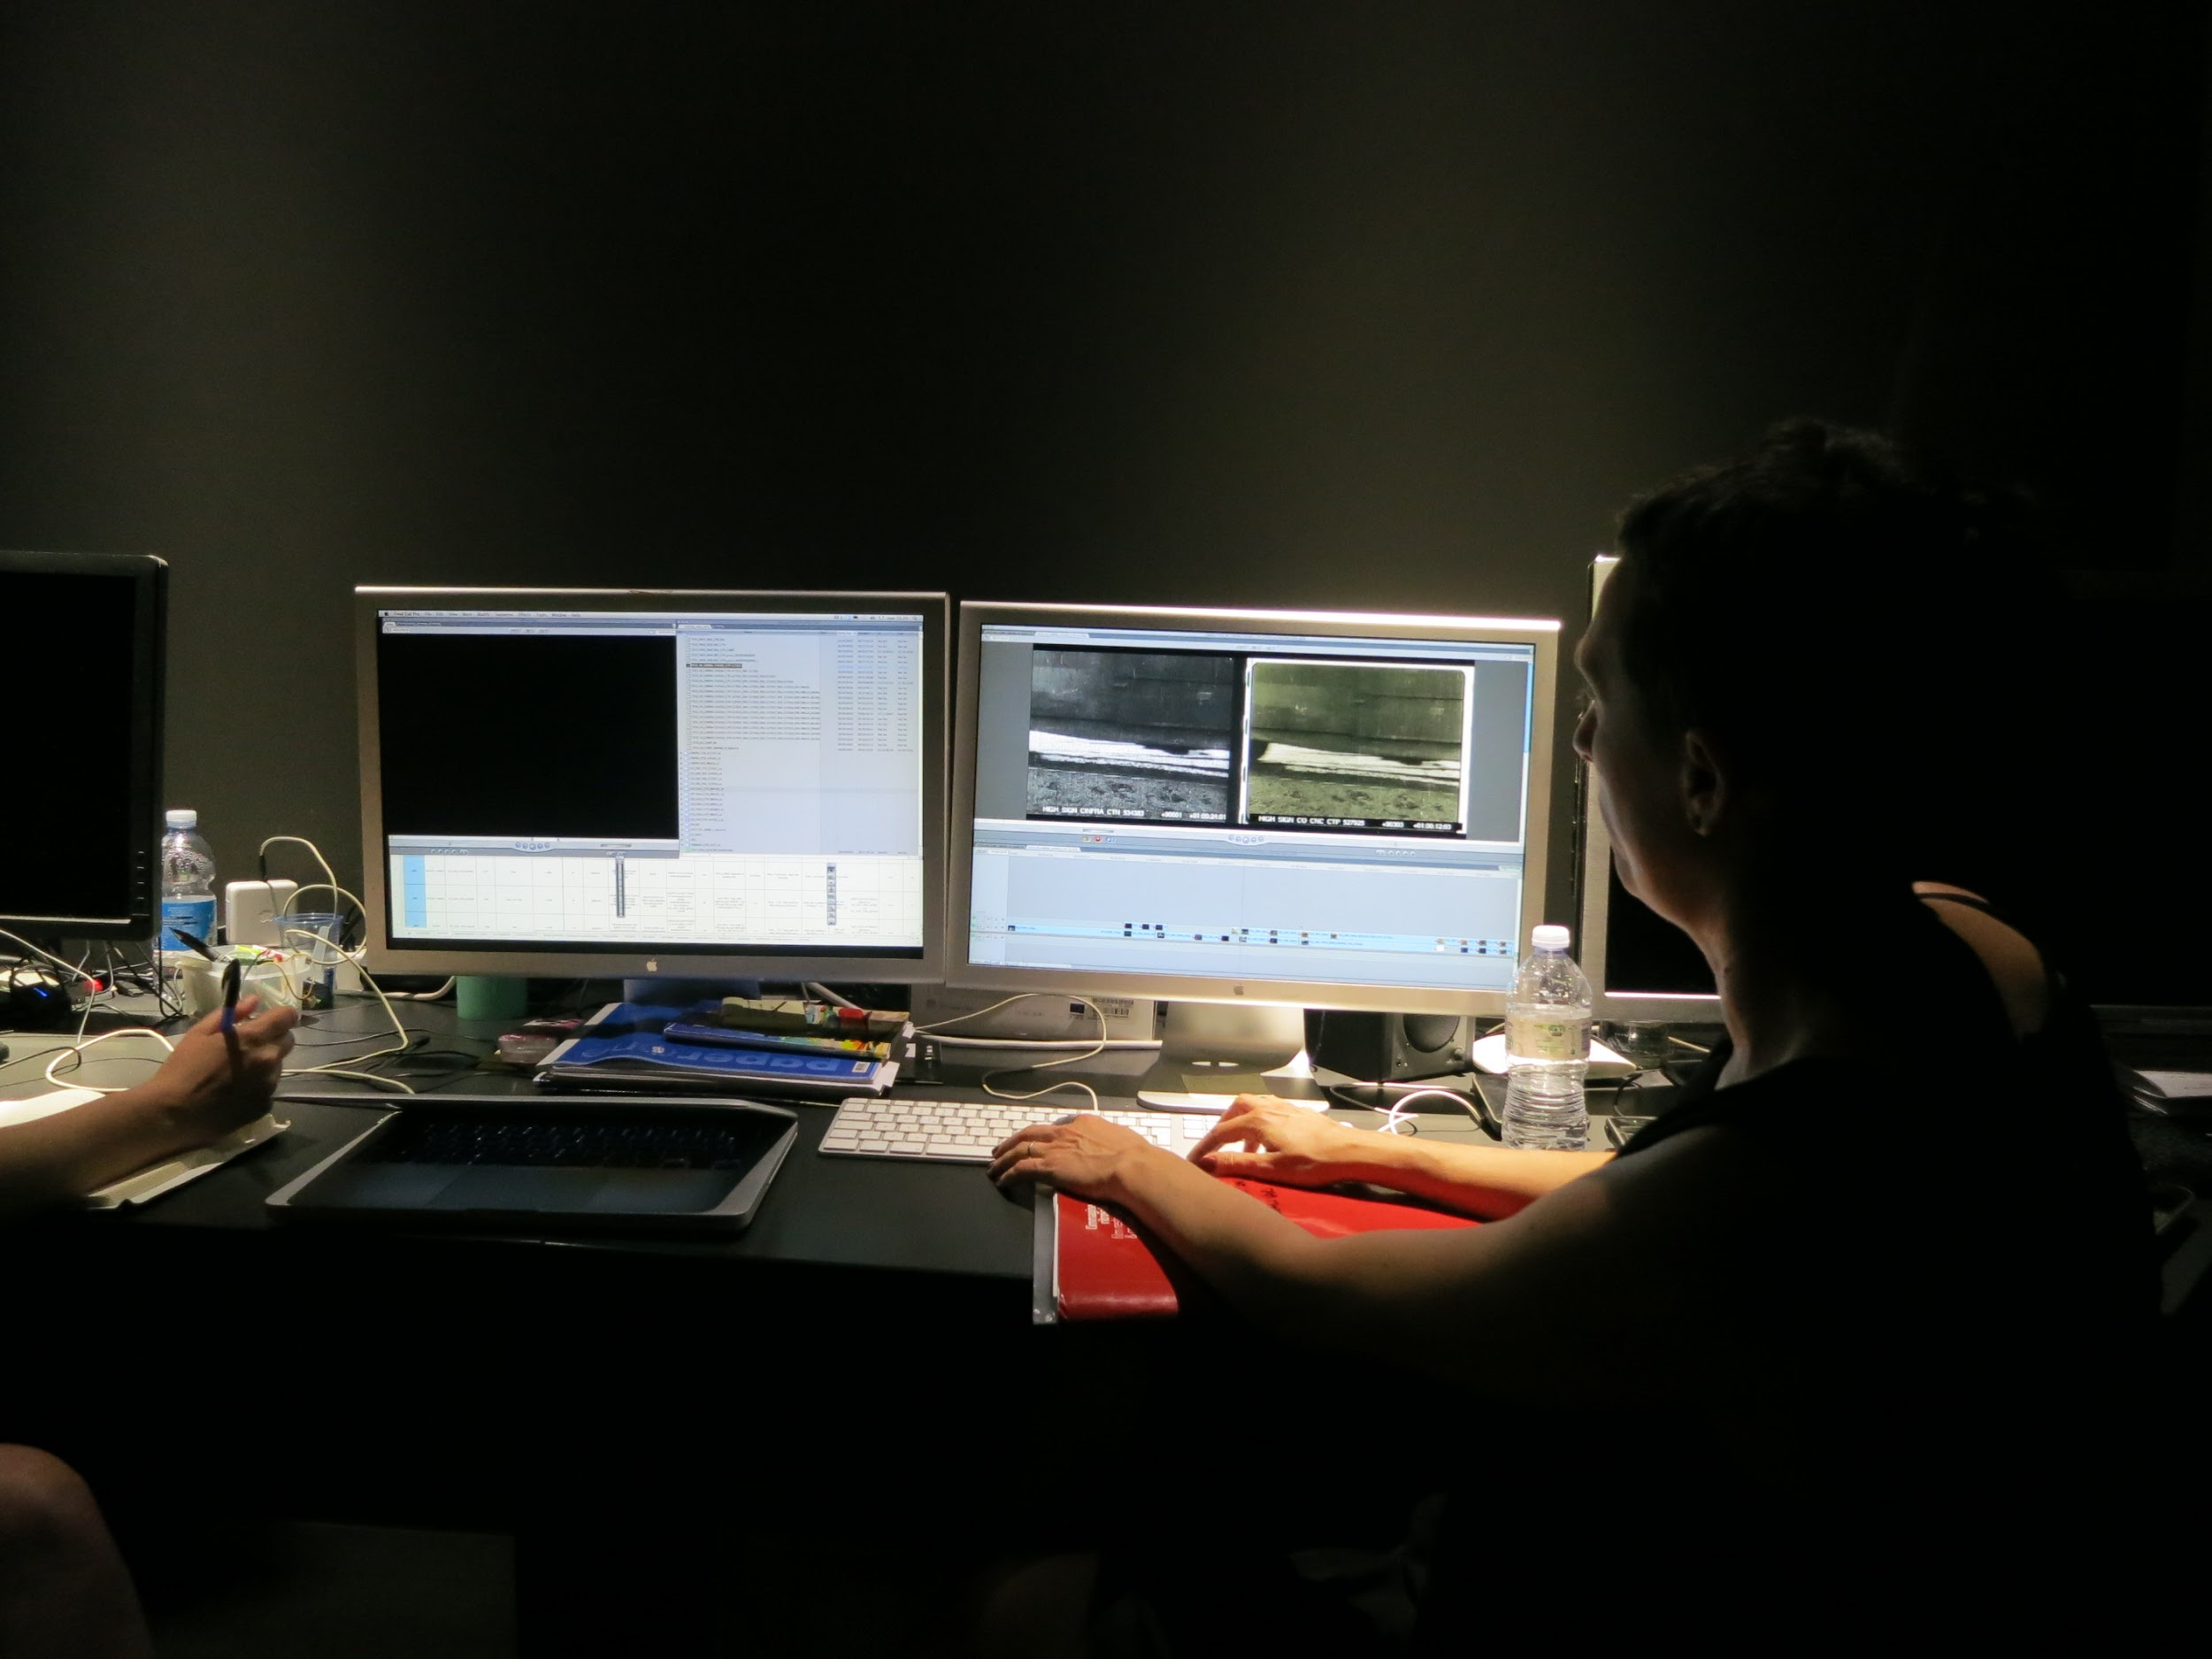
Film comparison in the L’Immagine Ritrovata lab. Photo: Kadi Sikka

Slide 57
DIGITAL RESTORATION

Slide 58
PHOENIX by Digital Vision
REVIVAL by Blackmagic
DIAMANT by HS Art

Slide 59
These tools complement, and are used in parallel with one another to carry out corrections on a wide range of problems and flaws, such as image stabilisation, deflickering, reconstruction etc. The software allows for a manual, semiautomatic or automatic workflow, which is supplemented by frame by frame correction.

Slide 60
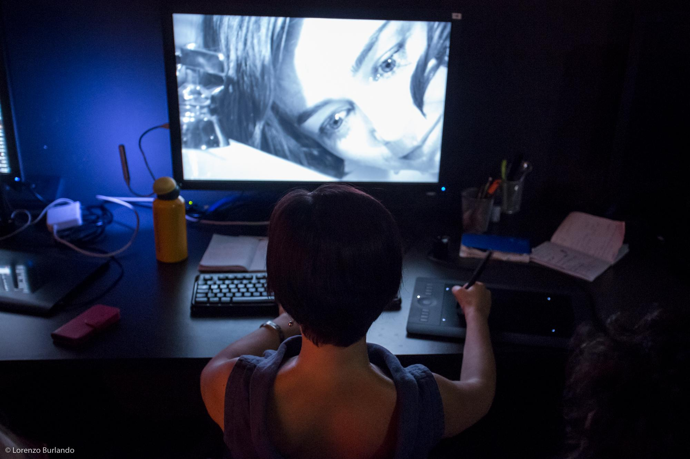
Digital restoration with Phoenix in the L’Immagine Ritrovata lab. Photo: Lorenzo Burlando

Slide 61
COLOUR CORRECTION

Slide 62
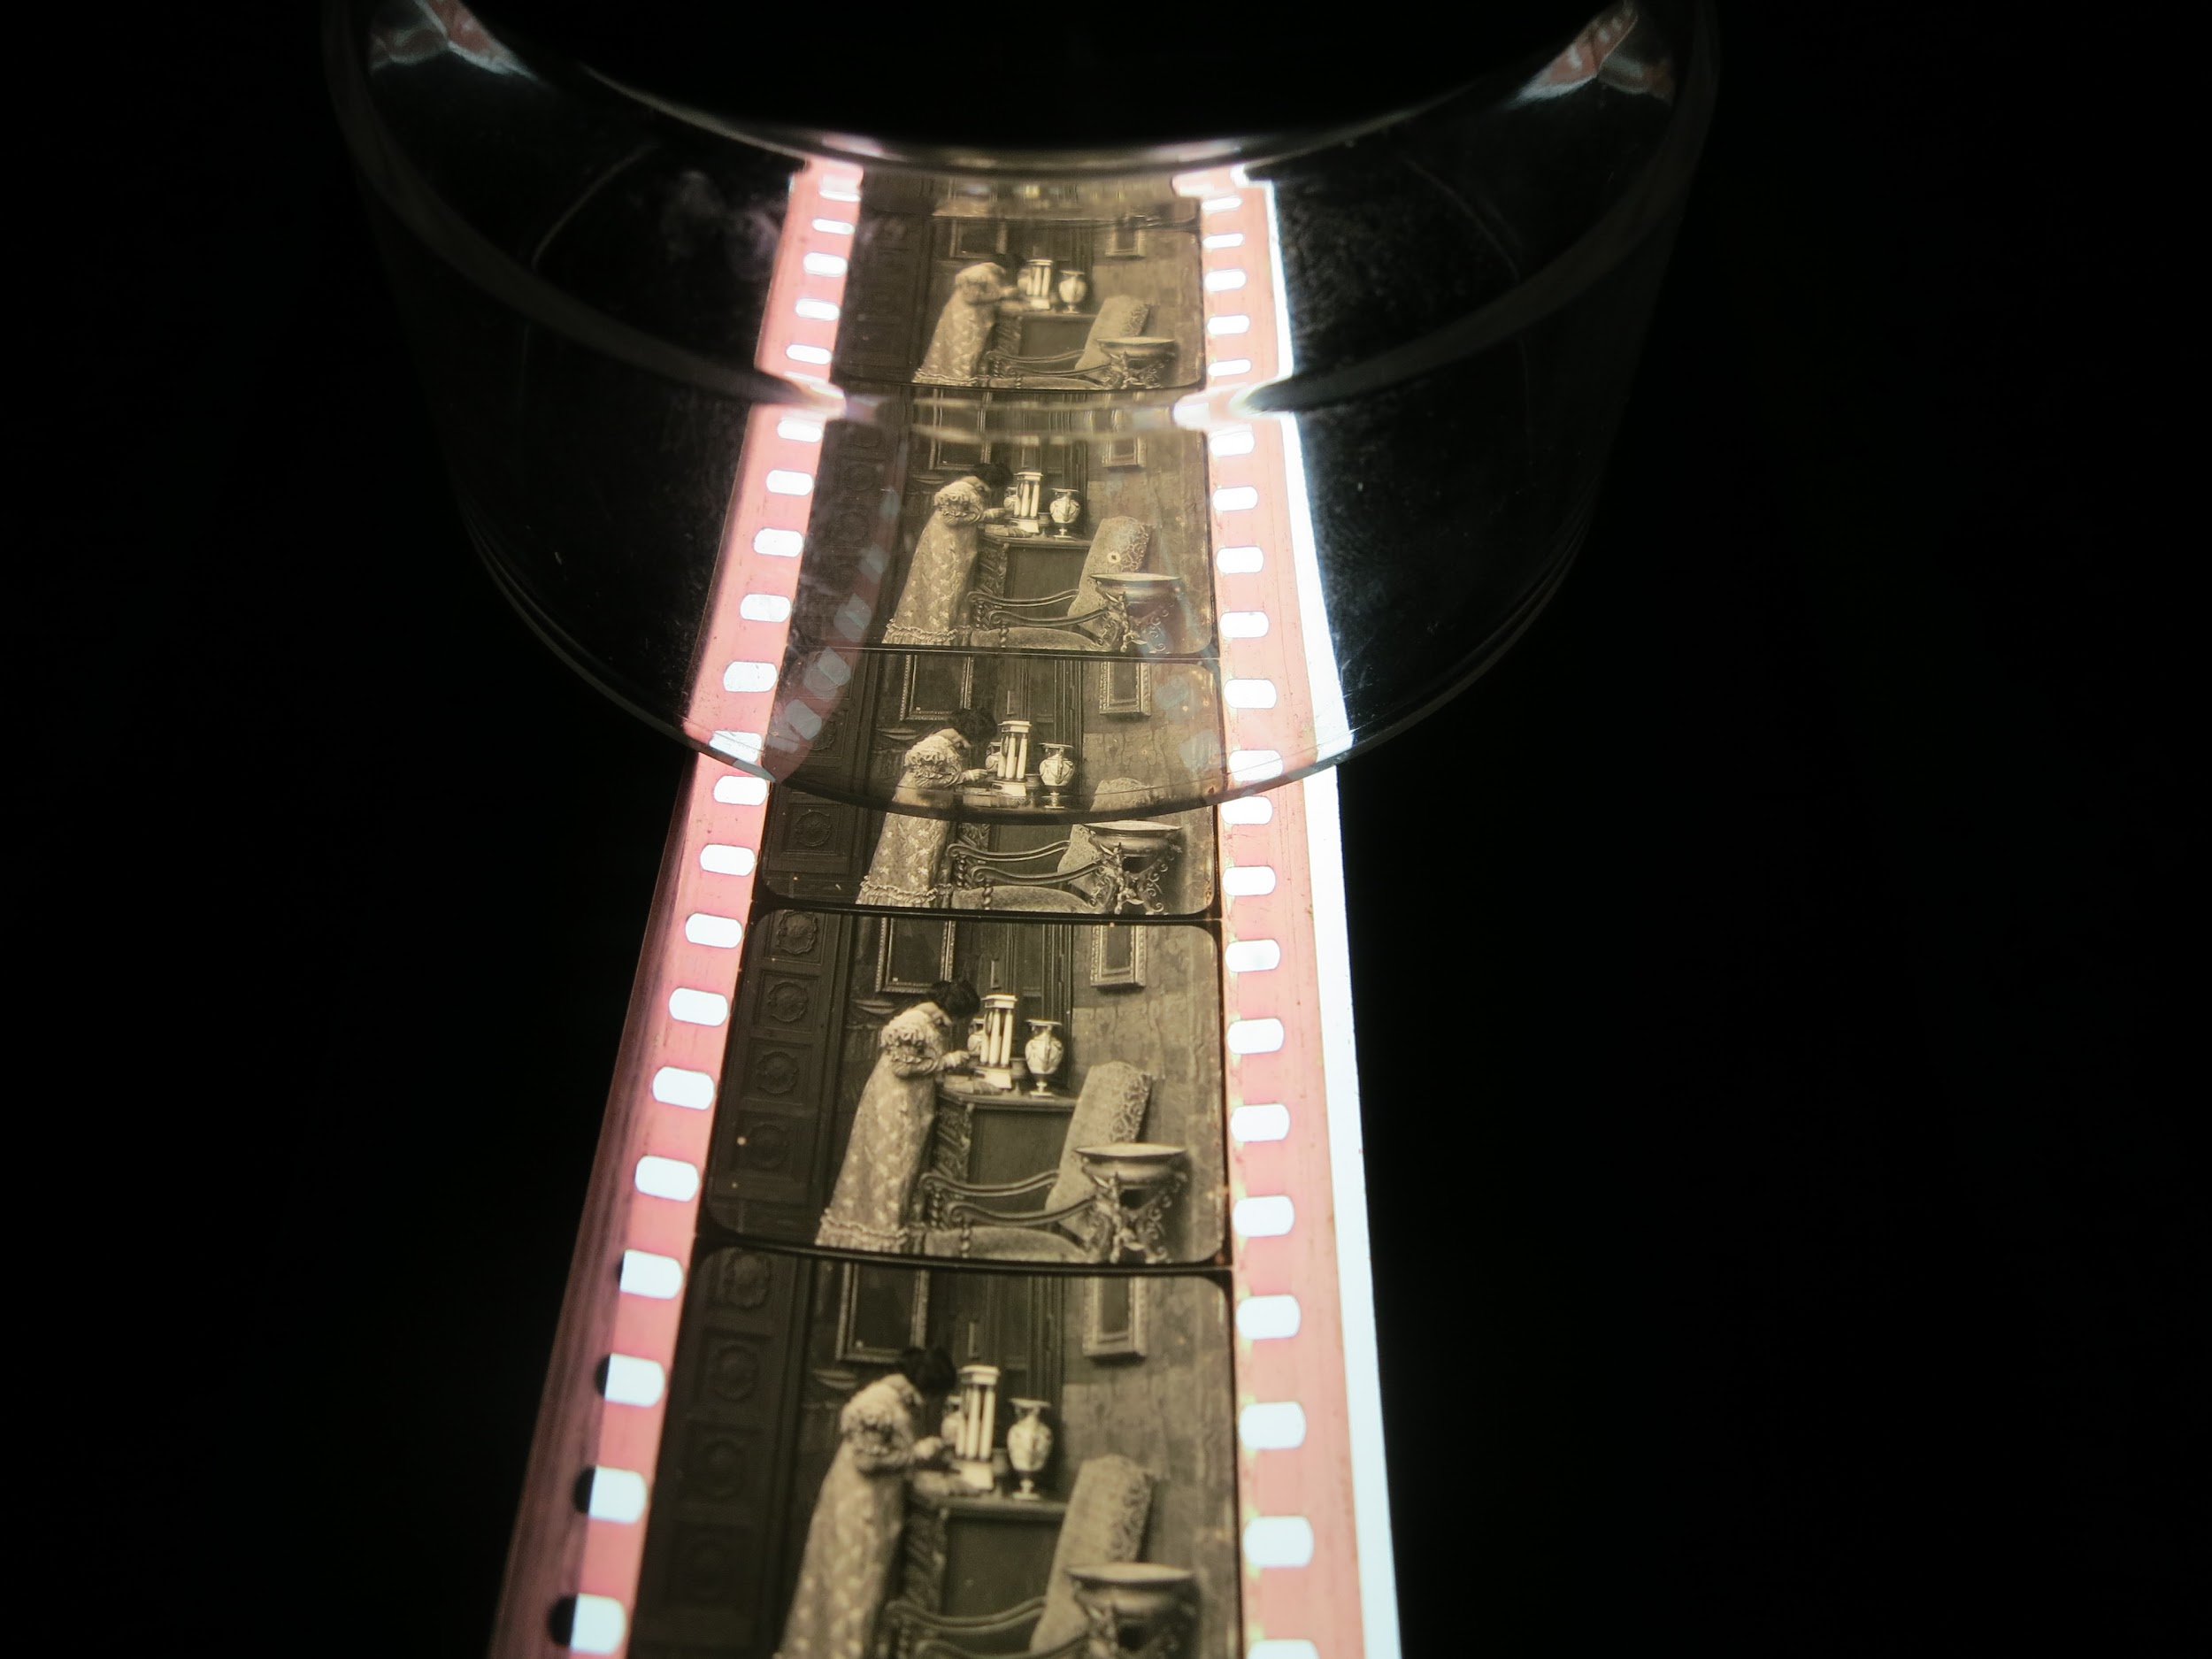
Colour correction in the L’Immagine Ritrovata lab. Photo: Kadi Sikka

Slide 63
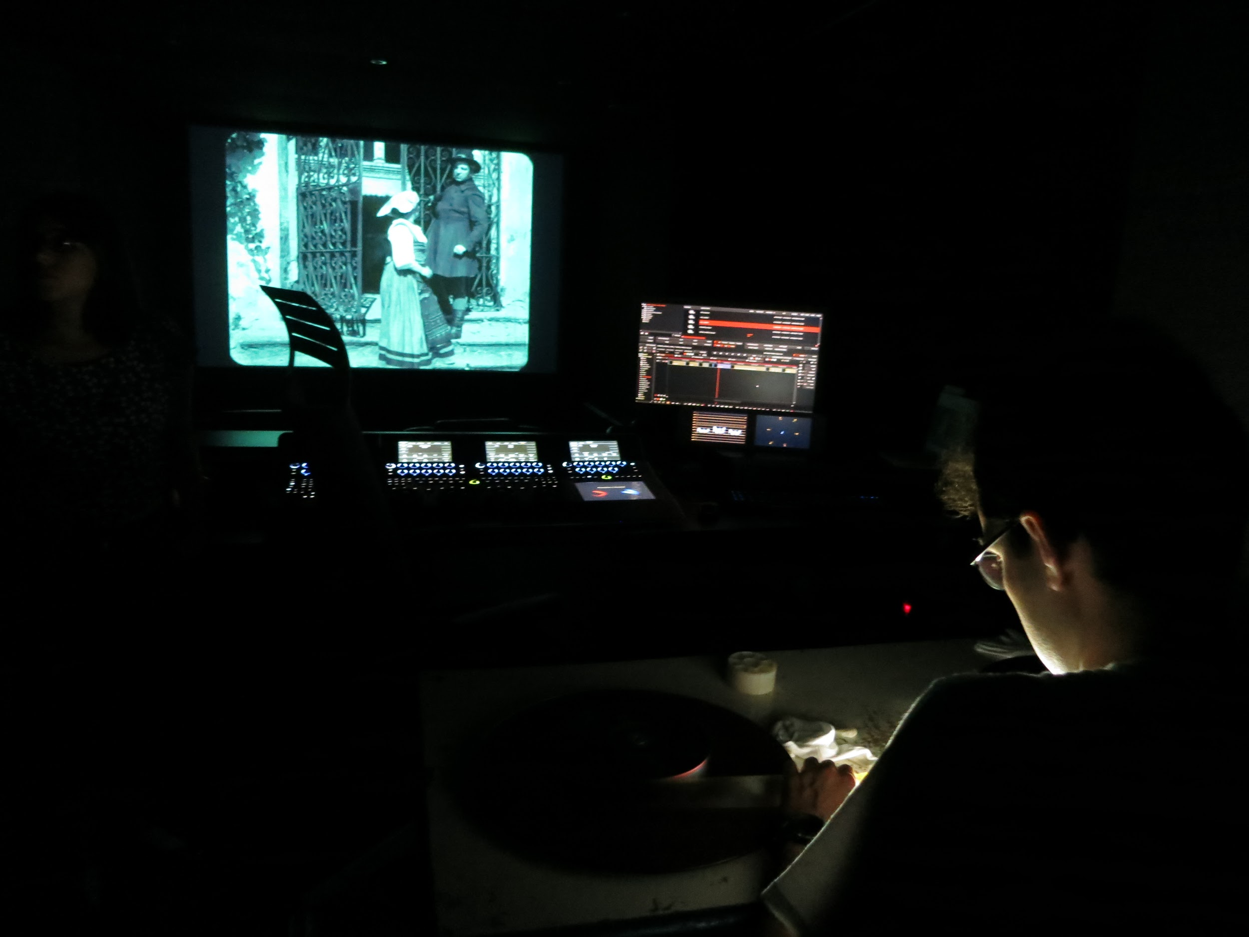
3.
2.
1.
3.
2.
1.
screen
screen
grading panel
grading panel
winding table
winding table
Colour correction studio in the L’Immagine Ritrovata lab. Photo: Kadi Sikka

Slide 64
CATALOGUING

Slide 65
WORK ➨ VARIANT ➨ MANIFESTATION ➨ ITEM
abstract entity
abstract entity (optional)
realisation, release, exhibition or distribution entity
physical or digital object
Source: The FIAF Moving Image Cataloguing Manual, 2016 - link

Slide 66
STORAGE

Slide 67
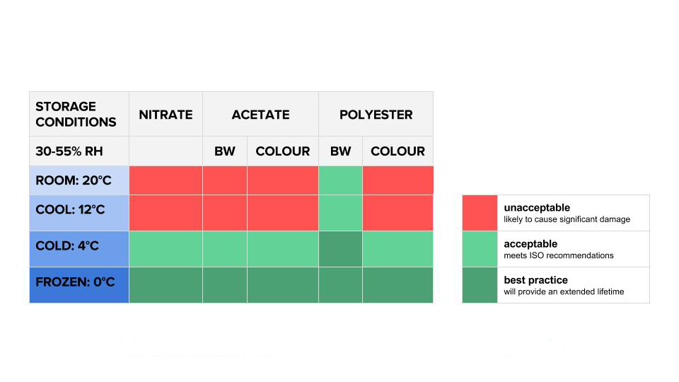
Storage conditions. Source: Image Permanence Institute - filmcare.org / link

Slide 68
LITERATURE AND INTERNET SOURCES
Brown, Harold. Physical Characteristics of Early Films as Aids to Identification. FIAF, 1990
Enticknap, Leo. Film Restoration. The Culture and Science of Audiovisual Heritage. London: Palgrave Macmillan, 2013
Walsh, David. “Approaches to Film Preservation and Archive Management”. - FIAF Film Restoration Summer School, 2016
A Guide to Identifying Year of Manufacture for KODAK Motion Picture Films. Kodak, 2013 - link
EU-standard for metadata (EN 15907) - link
filmcare.org - link
Film Duplication Resolution Tests. FIAF, 2014-2016 - link
Film Preservation Handbook. National Film&Sound Archive - link
Il Progetto Keaton (Youtube), L’Immagine Ritrovata, 2016 - link
L’Immagine Ritrovata - link
National Film and Sound Archive of Australia, Preservation - link
The FIAF Moving Image Cataloguing Manual. FIAF, 2016 - link
Timeline of Historical Film Colors - link

Slide 69
Insight into the FIAF Film Restoration Summer School 2016
Kadi Sikka
Film Archives of the National Archives of Estonia
2017

